Slide 1
“Kinect Fusion: HW Implementation and Acceleration of a Dense SLAM Algorithm” Final Report
ITRI EOSL Summer Intern Program
實習生 李承澔
NTHU EECS24 109020014

Slide 2
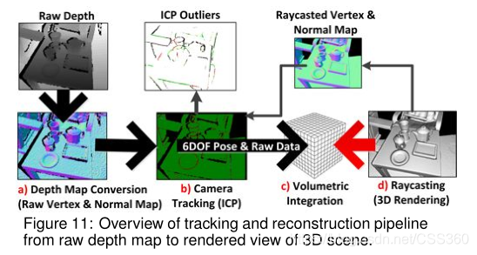
Kinect Fusion
Which is a algorithm reconstructs the 3D scenario from a depth map acquired from depth map by a depth camera or a stereo camera set.
It follows the workflow:

Slide 3
Kinect Fusion SW Implementation

Slide 4
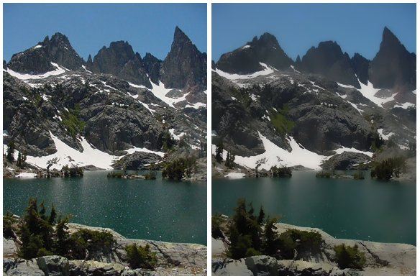
a) Depth Map Conversion – Bilateral Filter Kernel
The algorithm applies bilateral filter to reduce the noise of input depth.
Which applies a 5x5 slide window filter, which result in lots read operation.
Hence we implement line and window buffer in HW, to cache and reduce transactions.
Window Buffer
Line Buffer 1
Line Buffer 2
Line Buffer 3
Line Buffer 4
Line Buffer 5
Output Pixel
Input Pixel Stream

Slide 5
a) Depth Map Conversion – Half Sample Kernel
After the filter, Kinect Fusion construct scale pyramid and prepare scaled down depth map to compute vertex and normal in the latter stages.
Scaled Depth
Level 2
Scaled Depth
Level 1
Scaled Depth
Level 0

Slide 6
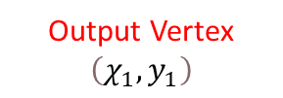
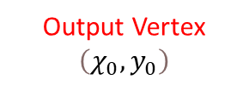
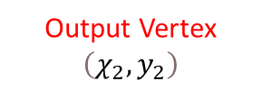
a) Depth Map Conversion – Depth 2 Vertex
Kinect Fusion will traverse all 3 scaled depth map and produce 3 set of vertex.
Output Vertex
$$\left(χ_{2},y_{2}\right)$$
Output Vertex
$$\left(χ_{1},y_{1}\right)$$
Output Vertex
$$\left(χ_{0},y_{0}\right)$$
If the depth of the target pixel is larger then threshold,
It notates the pixel a vertex

Slide 7
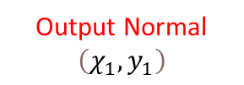
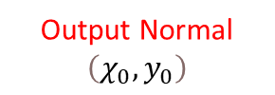
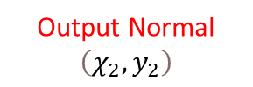
a) Depth Map Conversion – Vertex 2 Normal
Kinect Fusion will also traverse all 3 scaled vertex map and produce 3 set of normals.
Output Normal
$$\left(χ_{2},y_{2}\right)$$
Output Normal
$$\left(χ_{1},y_{1}\right)$$
Output Normal
$$\left(χ_{0},y_{0}\right)$$
It first examine the neighbors(up, down, left, right)
of the target pixel
Then produce the normal of the pixel

Slide 8
b) Camera Tracking – ICP Algorithm
Kinect Fusion will traverse all pixels, and match the vertex according to the depth and normal.
The algorithm uses an iterative approach to solve a least-squares problem, and gives the camera transformation matrix.
Vertex and Normal at time i-1
ICP outliers at time i-1
least-squares problem
Transformation
Matrix
Vertex and Normal at time i
ICP outliers at time i

Slide 9
c) Volumetric Integration
Kinect Fusion update the 3D voxels according the current camera position and vertex depth

